Slide 1
eMUNICIPALITY OF BAR
Danilovgrad, April 2012

Slide 2
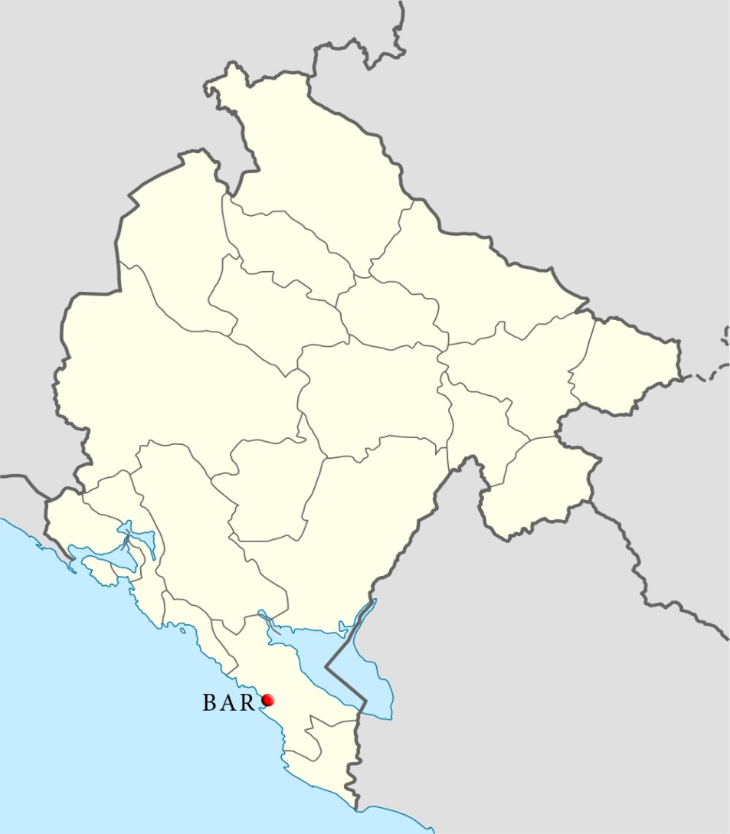
Municipality of Bar
Sea gateway to Montenegro
Surface: 505 m²
Population: 43.000
Tourism priority economic sector
45 km of Adriatic coast, 67 km Lake Skadar shore

Slide 3
eMunicipality of Bar
Project background
Number of population gets doubled over tourism season
Numerous companies operating in Bar – 10% of total number of companies in Montenegro
Relatively high number of employees working in six municipal departments
Legacy systems in some departments

Slide 4
eMunicipality of Bar
Project goals
Enhance services and operations of local government – long-term process
Improve efficiency, transparency and responsiveness of the administration through creation of a paperless government
Enable on line services for citizens
Enable integration of existing legacy systems
Easy accessible databases

Slide 5
eMunicipality of Bar
Project implementation
eMunicipality project was implemented in two stages:
  Procurement of computer equipment and configuration of IT infrastructure
  Software development
Customized software developed by agile approach

Slide 6
eMunicipality of Bar
Project implementation
Application simultaneously tested and corrected
Staff training on “1 to 1” basis
16 servers providing smooth operations of the information system
Clustered servers
UPSs and aggregate unit ensuring stability
Copies of the data stored outside municipal premises

Slide 7
eMunicipality of Bar
Paperless government benefits
Document processing entirely automated
Citizens bureau operating as one stop shop - all documents get scanned, hard copies stored;
Easy task assignment and workflow management
Automated information of employees of new incoming documents and deadlines
Easily made evidence

Slide 8
eMunicipality of Bar
Results
Increased efficiency and transparency
Provided on line services for citizens –documents’ status information, review of urban plans, problems reporting, direct contact with the Mayor;
Easier work for employees – all relevant documents available in the system, automated information regarding incoming documents and deadlines

Slide 9
eMunicipality of Bar
Major problems
Insufficient computer literacy of the staff
Continuous obstacles to the usage of the information system made by staff and middle management

Slide 10
eMunicipality of Bar
Lessons learned
Decision makers must be in the working team in charge of project implementation control
Registry of administrative procedures and formalities makes the implementation process easier
Results cannot be fully accomplished until the Municipality is able to issue electronic documents

Slide 11
eMunicipality of Bar
Conclusions
2010 - eMunicipality of Bar won the best practice award related to the introduction of ICTs in service delivery
Ongoing opposition of one part of the staff and middle management to the usage of this system
In 2010, as well as now, Bar Municipality was the only one in Montenegro to have automated the entire workflow

Slide 12
eMunicipality of Bar
Sanja Stanišić
Advisor to the Mayor for International and Public Relations
Tel. +382 30 301 406
Fax: +382 30 301 404
E-mail: sanja.stanisic@bar.me

